Slide 1
OS Project
Team Report (Final) Presentation

Slide 2
ThreadMentor: Dining Philosophers Problem Solution

Slide 3
Notes:
Next is Introduction Part
Danyil

Slide 4
1 Introduction
Background
The Dining Philosophers Problem
Outline/Layout of our Report
Notes:
Operating systems (OSes) play a key role in managing resources and facilitating the execution of multiple programs at the same time. One of the basic problems of OS design is correct synchronization of shared resources by multiple processes or threads, to avoid race conditions, deadlocks, and starvation of resources. Correct management of concurrency becomes increasingly vital as systems become increasingly powerful to support complex, multi-threaded applications.

Slide 5
Introduction
Concurrency and Synchronisation
Mutex Locks
Semaphores
ThreadMentor
Background
Notes:
Concurrency and Synchronisation Issues in OSes
Concurrency is when multiple threads or processes execute concurrently, either on multiple processors or by time-slicing on a single processor. While concurrency can improve performance and responsiveness, it introduces issues in ensuring that shared resources are accessed safely.
Common issues are:
Race conditions, where the output depends on the non-deterministic order of execution.
Deadlocks, where processes become stuck waiting for each other indefinitely.
Starvation, where certain processes are perpetually denied access to resources.
Mutex Locks
One of the most widely used synchronization mechanisms is the mutex (short for mutual exclusion) lock. A mutex ensures that only one thread can access a shared resource at a time. If one thread holds the mutex, other threads must wait until it is released.
Semaphores
A semaphore is another synchronization primitive that provides more flexibility than mutexes. Semaphores are typically used to control access to a pool of resources. They consist of an integer value that indicates the number of available resources.
ThreadMentor
ThreadMentor is a tool used to visualize and debug multi-threaded programs. It allows developers to track thread execution and observe synchronization issues in real time. With ThreadMentor, we can visualize the execution history of threads, highlight issues such as deadlocks or race conditions, and verify that our synchronization mechanisms, like mutexes and semaphores, are working as intended.

Slide 6
Introduction
The Dining Philosophers Problem is a classical problem in computer science that illustrates the challenges of managing concurrent processes and shared resources.
The Dining Philosophers Problem
Notes:
The Dining Philosophers Problem is a classical problem in computer science that illustrates the challenges of managing concurrent processes and shared resources.
I think, everyone there know what this is, so let’s move on to the next slide.
The scenario involves a number of philosophers sitting at a table, each with a bowl of pasta and two forks. They need both forks to eat, but there are only as many forks as philosophers, leading to the potential for deadlock and resource contention.
The problem requires careful synchronization to ensure that philosophers can eat without encountering deadlocks or starvation.

Slide 7
Introduction
Section 1 is this, the Introduction
Section 2 covers the introduction of the Mutex Lock Solution
Section 3 provides a thorough Results and Analysis
In Section 4, we state our Conclusions
Outline/Layout of our Report
Notes:
There is 2 main section in our presentation: Mutex Lock Solution (Section 2) and Results and Analysis (Section 3).
And Introduction (Section 1) with Conclusions (Section 4) Section 1 is this, the Introduction
Section 2 covers the introduction of the Mutex Lock Solution
Section 3 provides a thorough Results and Analysis
In Section 4, we state our Conclusions
Section 5 is the list of References
Section 6 contains a reflexive section
Finally, Section 7 records our Project Planning and Management

Slide 8
Notes:
Next is Mutex Lock Solution Part
Emanuel

Slide 9
2 Mutex Lock Solution
Theory/How it works
ThreadMentor

Slide 10
Mutex Lock Solution
We chose the 1st solution on the ThreadMentor e book website.
Why?
Mutex Locks seemed interesting & there are many talking points.

Slide 11
Mutex Lock Solution
Thread = Philosopher
Mutex Lock = Chopstick
Shared Resource = Food
Thread needs 2 Mutex locks, and that's it.
How it works

Slide 12
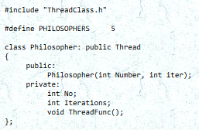
Mutex Lock Solution
Philosopher.h

Slide 13
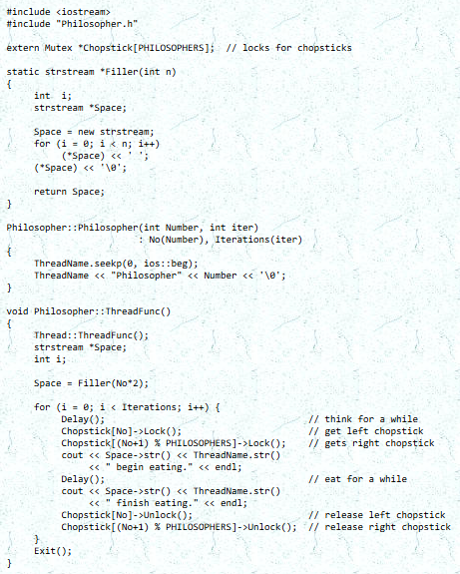
Mutex Lock Solution
Philosopher.cpp

Slide 14
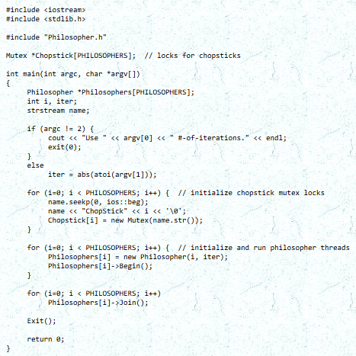
Mutex Lock Solution
Philosopher-main.cpp

Slide 15
Notes:
Next is Results and Analysis Part
Danyil, Artem, Emanuel

Slide 16
3 Results and Analysis
Program Execution Overview
Program Execution Window Explaining
History Graph & Thread Status Screenshots and Captions
Code Snippets Corresponding to ThreadMentor Tags
Detailed Behavior Analysis of Philosopher Threads
Discussion of Deadlock and Starvation Risks

Slide 17
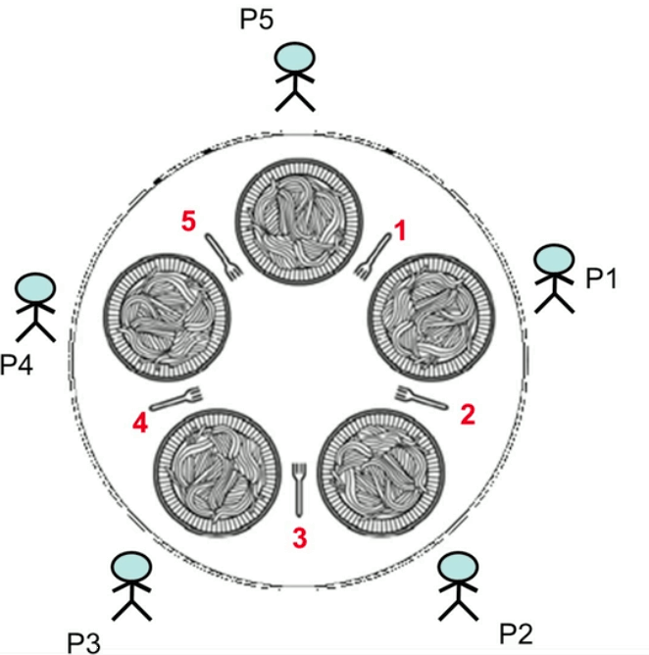
Program Execution Overview
Key Parameters:
5 Philosopher Threads
5 Chopstick Mutex Locks
3 Thinking-Eating Cycles

Slide 18
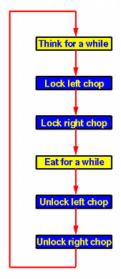
Execution Phases
1. Initialization
Create 5 mutex locks (chopsticks)
Spawn 5 philosopher threads
2. Execution
Think → Grab Left → Grab Right → Eat → Release Both
3. Termination
Threads complete 3 cycles
Join all threads
End simulation
Notes:
Next is Program Execution Overview Part
Artem

Slide 19
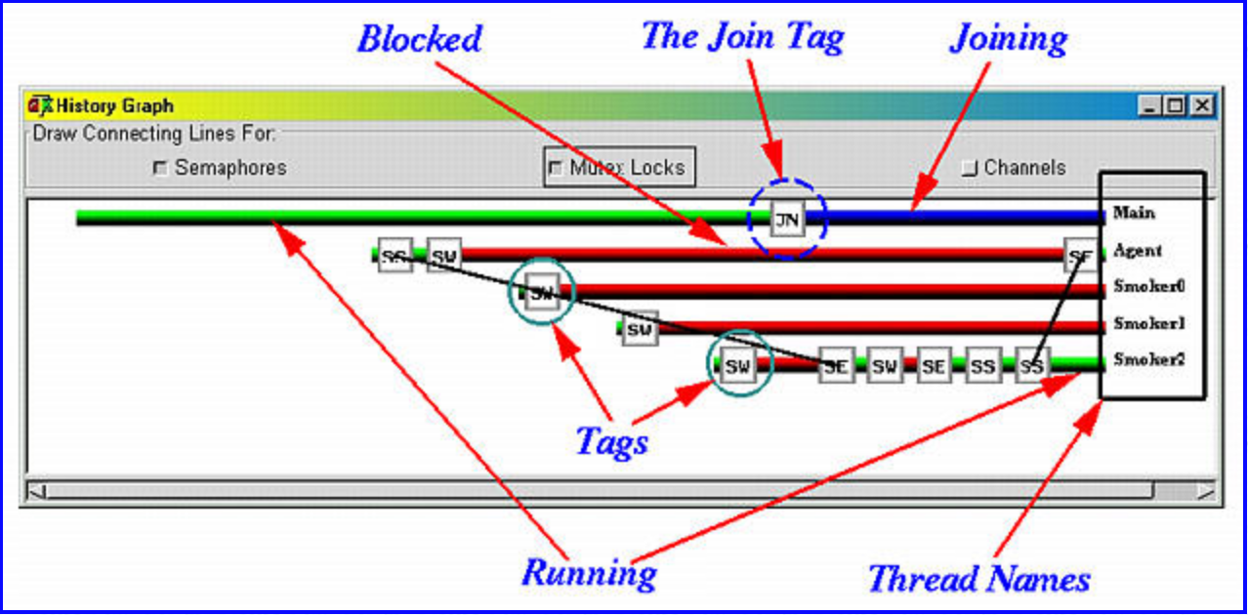
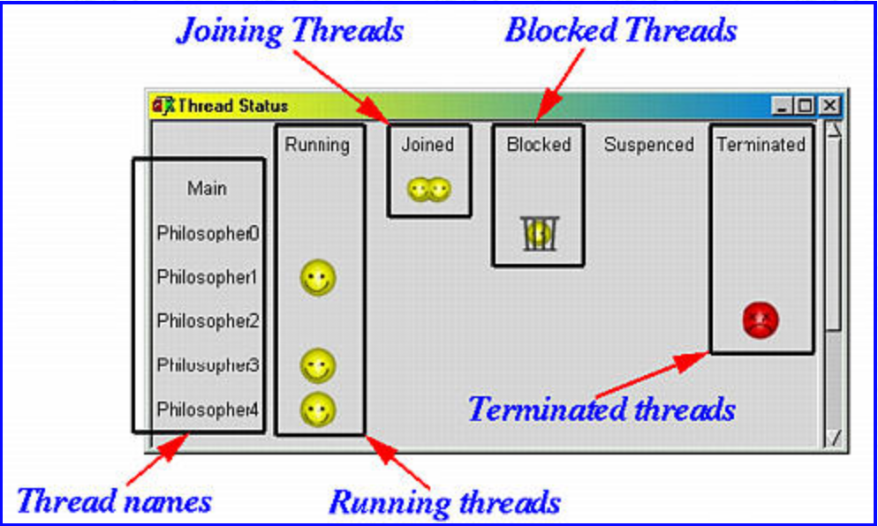
3.2 Program Execution Window Explaining
Thread Status Window
History Graph

Slide 20
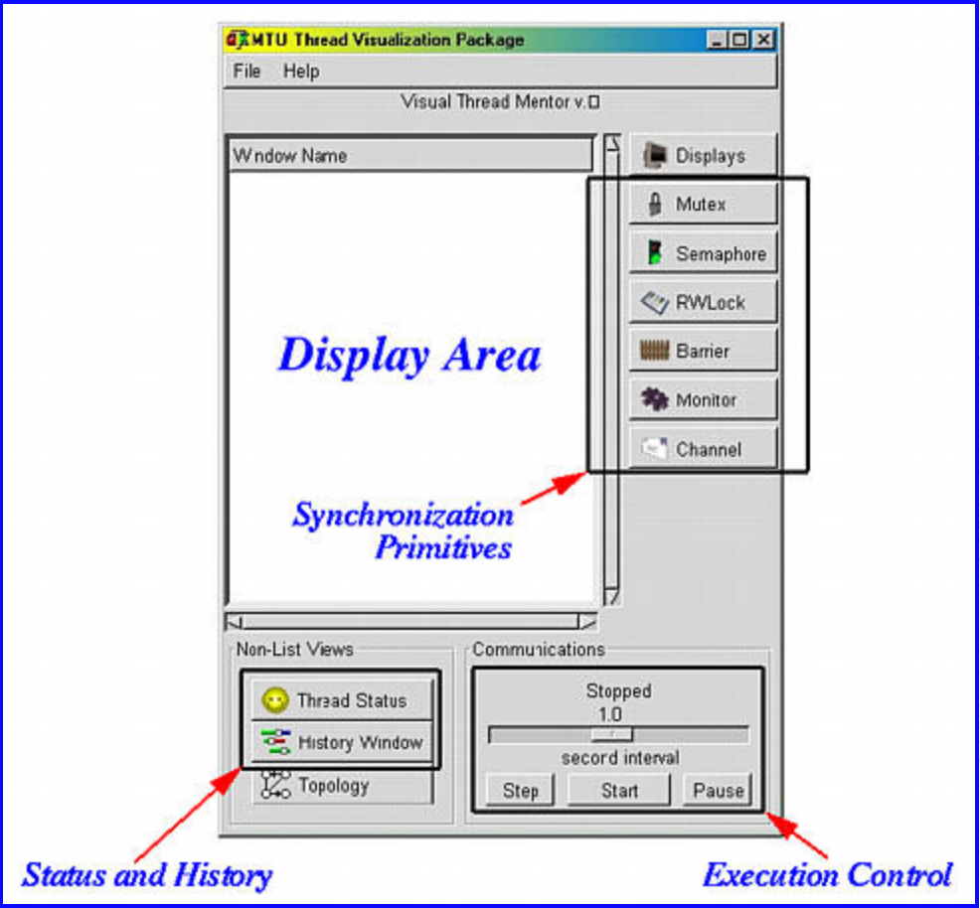

ThreadMentor Main Window
Thread Status Window Details
Notes:
Next is Program Execution Window Explaining Part
Artem

Slide 21
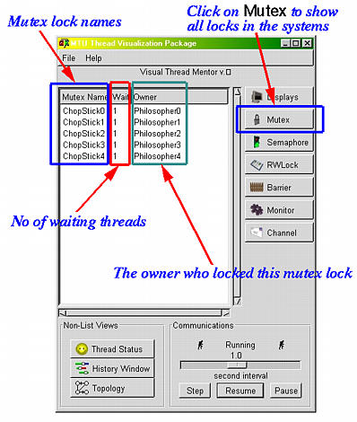
Mutex Locks Window
Notes:
Next is History Graph & Thread Status Screenshots and Captions Part
Emanuel

Slide 22
3 Results and Analysis
History Graph & Thread Status Screenshots and Captions

Slide 23
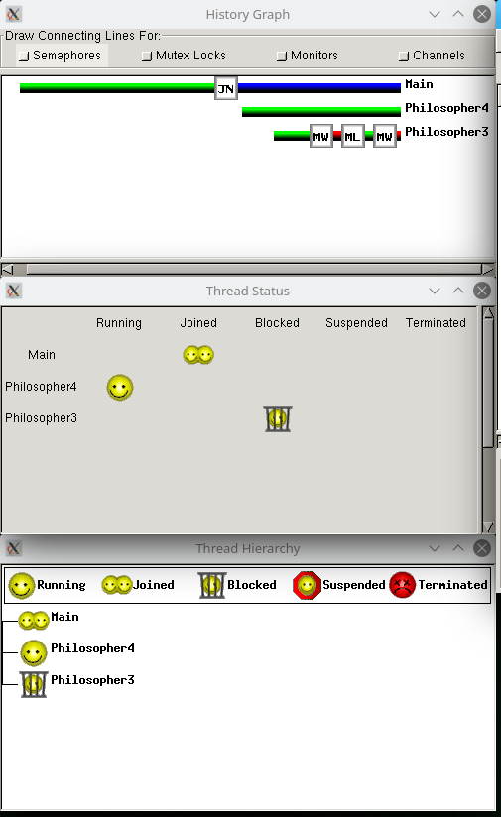
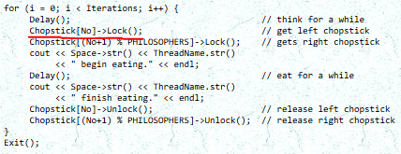
History Graph & Thread Status explanation

Slide 24
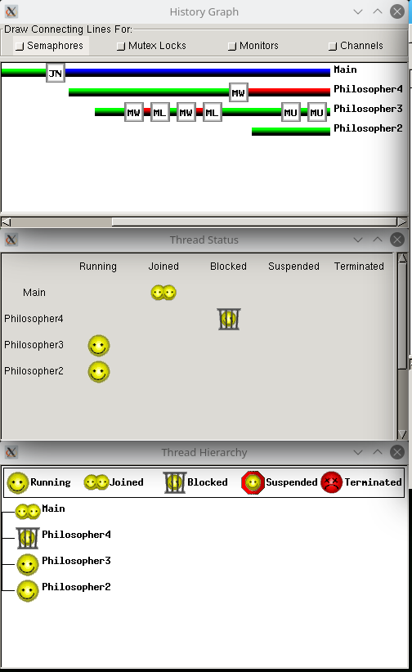
History Graph & Thread Status explanation

Slide 25
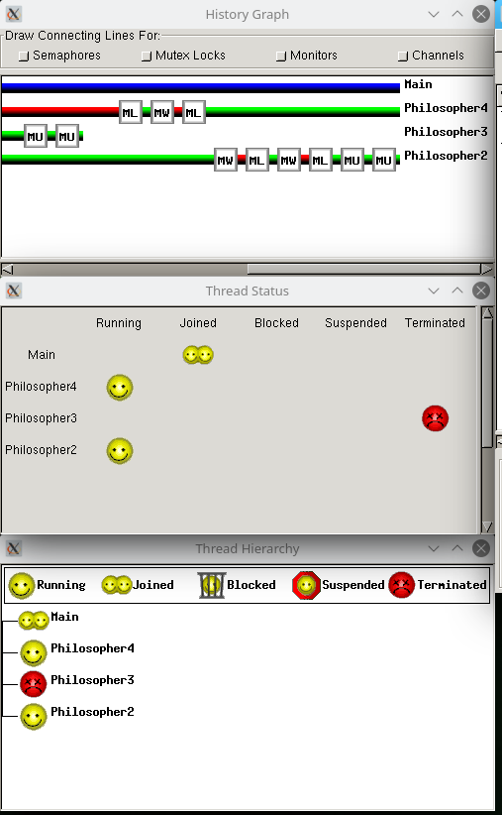
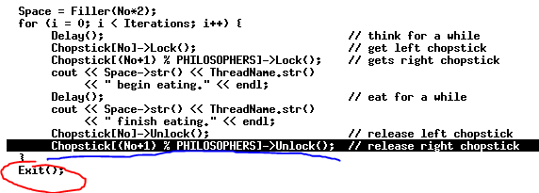
History Graph & Thread Status explanation

Slide 26
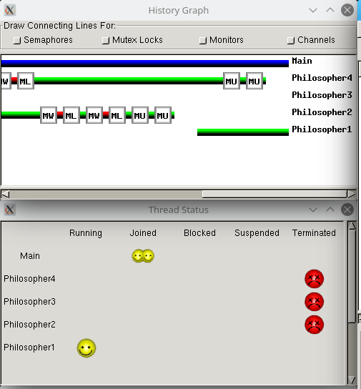
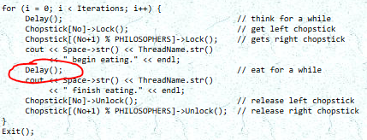
History Graph & Thread Status explanation

Slide 27
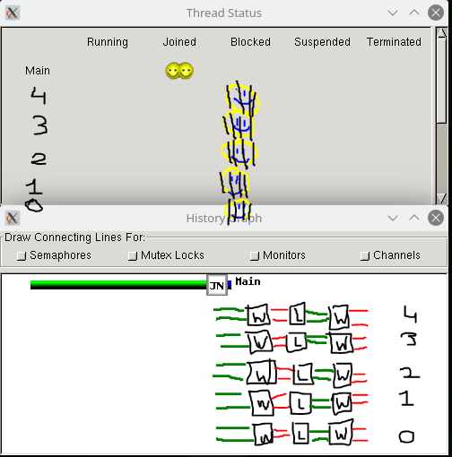
History Graph & Thread Status explanation

Slide 28
3 Results and Analysis
Code Snippets Corresponding to ThreadMentor Tags
Notes:
This iis Code Snippets Corresponding to ThreadMentor Tags Part
Danyil

Slide 29
Philosopher.h Philosopher.cpp Philosopher-main.cpp
Notes:
There are three code files in this implementation
Philosopher-main.cpp starts the program:
Sets up synchronization tools (Mutex chopsticks).
Launches five Philosopher threads.
Each Philosopher thread (defined in Philosopher.cpp) follows the same pattern:
Think → Lock chopsticks → Eat → Unlock chopsticks.
Philosopher.h ties everything together by providing the class blueprint used by the main file.

Slide 30
Philosopher.h
Notes:
Philosopher.h — Interface for the Philosopher Thread
Purpose: Declares the Philosopher class, which is derived from the Thread class provided by ThreadMentor.
What it defines:
Constructor for initializing a philosopher with their number and number of iterations.
The ThreadFunc() method, which is the core behavior executed by each philosopher thread.
Keeps track of the philosopher’s ID number and how many times they think and eat.
ThreadMentor Concepts:
Custom thread class
Inheritance from Thread
Thread encapsulation

Slide 31

Philosopher.h
Class Definition for Philosopher
Philosopher.h (line 13 - 21)
Notes:
Class Definition for Philosopher
Tag: Thread Class Declaration, Inheritance from Thread
Explanation:
Philosopher is a thread class derived from Thread.
No stores the philosopher’s number (0–4).
Iterations defines how many times the philosopher will think and eat.
ThreadFunc() is a mandatory override that specifies what the thread will do when running.

Slide 32
Philosopher.cpp
Notes:
Philosopher.cpp — Implementation of Philosopher Behavior
Purpose: Implements what each philosopher actually does when their thread is running.
What it does:
Uses a helper function (Filler) to align output.
In ThreadFunc():
Each philosopher thinks (Delay()), picks up left then right chopstick (mutex locks), eats, and puts down chopsticks (mutex unlocks).
This sequence repeats for a specified number of iterations.
Calls Exit() when done
ThreadMentor Concepts:
Thread entry point via ThreadFunc()
Synchronization using Mutex locks
Possible deadlock risk due to fixed order of resource acquisition
Thread termination with Exit()

Slide 33
Philosopher.cpp
External Declaration of Chopsticks
Philosopher.cpp (line 12)
Notes:
External Declaration of Chopsticks
Tag: Shared Synchronization Object
Explanation:
Chopstick is an array of pointers to Mutex objects, one for each chopstick.
It is extern, meaning that the actual definition is elsewhere (in main file).

Slide 34
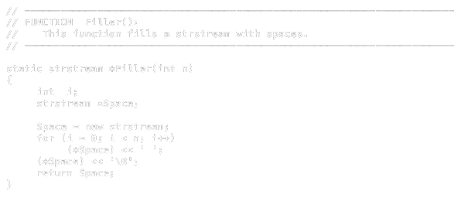
Philosopher.cpp
Helper Function: Filler()
Philosopher.cpp (line 14 - 29)
Notes:
Helper Function: Filler()
Tag: Formatting Utility (Not ThreadMentor Specific)
Explanation:
Allocates and returns a stream with n spaces, used to indent output for visual clarity.

Slide 35
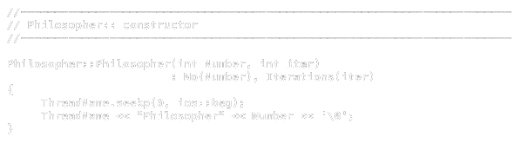
Philosopher.cpp
Philosopher Constructor
Philosopher.cpp (line 31 - 40)
Notes:
Philosopher Constructor
Tag: Thread Initialization, Thread Naming
Explanation:
Initializes the philosopher's ID (No) and number of Iterations.
Sets a readable thread name like Philosopher0, Philosopher1, etc., which is useful for debugging and logs.

Slide 36
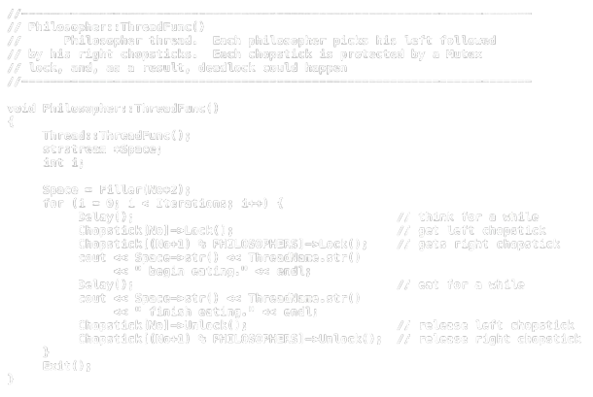
Philosopher.cpp
Main Thread Functionality
Philosopher.cpp (line 31 - 40)
Notes:
Main Thread Functionality
Tag: Critical Section Protection (Mutex Lock/Unlock), Thread Behavior Definition, Thread Termination
Explanation:
The philosopher thinks (Delay()), locks both needed chopsticks (left then right), eats, and unlocks the chopsticks.
Important: locking left and then right may cause deadlock, because all philosophers could be waiting for each other's second chopstick.
The Exit() call properly ends the thread after all iterations.

Slide 37
Philosopher-main.cpp
Notes:
Philosopher-main.cpp — Main Program and Thread Setup
Purpose: Sets up the environment, initializes mutexes and threads, and coordinates execution.
What it does:
Parse command-line argument for number of iterations.
Creates Mutex locks (chopsticks) with unique names.
Instantiates and starts philosopher threads using Begin().
Waits for all philosophers to finish using Join().
Terminates program using Exit().
Uses a helper function (Filler) to align output.
In ThreadFunc():
Each philosopher thinks (Delay()), picks up left then right chopstick (mutex locks), eats, and puts down chopsticks (mutex unlocks).
This sequence repeats for a specified number of iterations.
Calls Exit() when done
ThreadMentor Concepts:
Mutex creation and naming
Thread instantiation and Begin()
Thread synchronization with Join()
Clean thread and program termination

Slide 38
Philosopher-main.cpp
Global Chopstick Array
Philosopher-main.cpp (line 10)
Notes:
Global Chopstick Array
Tag: Shared Synchronization Resource
Explanation:
Defines the array of chopsticks that will be locked/unlocked by the philosophers.

Slide 39

Philosopher-main.cpp
Main Function: Setup and Start
Philosopher-main.cpp (line 18 - 23)
Notes:
Main Function: Setup and Start
Tag: Command Line Argument Parsing (Setup)
Explanation:
Parses the number of eating/thinking iterations from the command line.

Slide 40

Philosopher-main.cpp
Chopstick Mutex Creation
Philosopher-main.cpp (line 10)
Notes:
Chopstick Mutex Creation
Tag: Mutex Object Creation
Explanation:
Creates a Mutex for each chopstick with a unique name like ChopStick0, ChopStick1, etc.

Slide 41

Philosopher-main.cpp
Philosopher Thread Creation and Launch
Philosopher-main.cpp (line 10)
Notes:
Philosopher Thread Creation and Launch
Tag: Thread Creation, Thread Execution Start
Explanation:
Initializes each philosopher object and calls Begin() to start each thread's execution.

Slide 42

Philosopher-main.cpp
Wait for All Threads to Finish
Philosopher-main.cpp (line 10)
Notes:
Wait for All Threads to Finish
Tag: Thread Join / Synchronization
Explanation:
Main thread waits for all philosopher threads to complete their eating/thinking cycles.

Slide 43

Philosopher-main.cpp
Final Exit
Philosopher-main.cpp (line 10)
Notes:
Final Exit
Tag: Program Termination
Explanation:
Exits the main thread and the program cleanly after all threads are joined.

Slide 44
Notes:
Next is Detailed Behavior Analysis of Philosopher Threads Part
Artem

Slide 45

3.5 Detailed Behavior Analysis of Philosopher Threads
Key Observations:
Success of mutex lock solution
Varying resource contention patterns
No deadlocks occurred
At most 2 philosophers eating concurrently

Slide 46
Philosopher 0 Behavior
Philosopher 1 Behavior
Key Patterns:
Initial thinking: ~800ms
Brief blocking: ~300ms waiting for right chopstick
Eating phase: ~600ms
Released right chopstick before left
Key Patterns:
Highest resource competition
Longest waiting periods (1.4s total)
Consistent eating duration: 500-700ms
Clear running/blocked state transitions
Notes:
Next is Discussion of Deadlock and Starvation Risks Part
Artem

Slide 47
Philosopher 2 Behavior
Philosopher 3 Behavior
Philosopher 4 Behavior
Key Patterns:
Most balanced execution pattern
Brief blocking periods: 100-200ms
Efficient resource utilization
Highest cycle consistency
Key Patterns:
Minimal waiting times
Time distribution: 45% thinking, 40% eating, 15% waiting
Rapid lock-unlock sequences
Low interference with neighbors
Key Patterns:
Potential starvation risk
One instance of ~700ms wait
Longer resource holding (~800ms avg)
Typically last to complete cycles
Notes:
Next is Detailed Behavior Analysis of Philosopher Threads Part
Artem

Slide 48
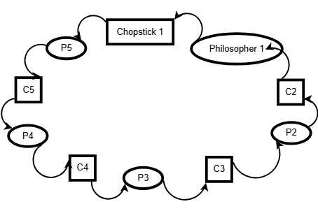
3.6 Deadlock Risk Analysis
Key Deadlock Risks:
Circular wait potential
Hold-and-wait condition present
Near-deadlock moments observed

Slide 49
Starvation Risk Analysis
Starvation Vulnerabilities:
Positional disadvantages observed
No fairness guarantees in mutex implementation
Consistent timing imbalances detected
Theoretical unlimited waiting possible
Notes:
Next is Conclusions Part
Danyil

Slide 50
Mitigation Factors
Factors Preventing Deadlock & Starvation:
Random delay variations
Limited iterations (3 cycles)
OS thread scheduling variability
Resource release ordering
Notes:
Next is Conclusions Part
Danyil

Slide 51
4 Conclusions
The Dining Philosophers Problem helped us understand real-world concurrency issues.
Mutex locks ensured safe access to shared resources.
ThreadMentor allowed us to visualize thread behavior and detect issues.
We gained hands-on experience with synchronization in operating systems.
Notes:
In this project, we explored how operating systems handle concurrency using the Dining Philosophers Problem. We used mutex locks to make sure that threads didn’t access shared resources at the same time, helping to avoid issues like deadlocks and starvation. With the help of ThreadMentor, we could clearly see how our solution worked and where problems might happen. Overall, this project helped us better understand synchronization and how to manage multiple threads safely in real systems.
The Dining Philosophers Problem helped us understand real-world concurrency issues.
Mutex locks ensured safe access to shared resources.
ThreadMentor allowed us to visualize thread behavior and detect issues.
We gained hands-on experience with synchronization in operating systems.

Slide 52
5 References
Dining Philosophers Solution
Code files:
Philosopher.h
Philosopher.cpp
Philosopher-main.cpp
Other references:
System Overview
What is Makefile and make? How do we use it?
Notes:
This is References Part

Slide 53
6 Appendix: Personal Reflections
What We Learned
What We Liked About the Project
What We Didn't Like About the Project
What We Would Do Differently
Recommendations for Future Students
Notes:
This is Appendix: Personal Reflections Part
Artem
What We Learned
This project provided invaluable hands-on experience with concurrent programming concepts that were previously only theoretical to us. We gained a deep understanding of mutual exclusion, thread synchronization challenges, and resource allocation strategies. Learning to use ThreadMentor as a visualization tool was particularly enlightening, as it allowed us to actually see concepts like thread blocking and resource contention that are otherwise abstract.
The most significant learning came from seeing how seemingly simple concurrent algorithms can lead to complex emergent behaviors when multiple threads interact. Understanding the subtle relationship between implementation decisions and the resulting thread behaviors has given us a much more intuitive grasp of operating system design principles.
What We Liked About the Project
The practical nature of the project was its strongest aspect. Implementing a classic synchronization problem and then visualizing the execution provided immediate feedback on our design decisions. We particularly appreciated how the Dining Philosophers problem elegantly captures fundamental OS challenges in a comprehensible scenario.
The ThreadMentor tool was exceptionally useful for debugging and analysis. Being able to see thread states change in real-time and correlate these with code execution made abstract concepts concrete and helped build an intuitive understanding of concurrent behavior that would be difficult to develop through code inspection alone.
What We Didn't Like About the Project
The initial setup of the ThreadMentor environment was challenging and time-consuming. Better documentation or a streamlined installation process would have allowed us to focus more on the core learning objectives rather than environment configuration.
Additionally, while the mutex solution was instructive, I would have appreciated the opportunity to implement and compare multiple solutions (such as semaphore-based approaches or solutions using condition variables) within the same project to better understand their relative strengths and weaknesses.
What We Would Do Differently
If we were to approach this project again, we would:
Begin with a more thorough theoretical analysis of potential deadlock and starvation scenarios before implementation, which would have helped guide our design decisions more deliberately.
Implement a more sophisticated logging system within the code to collect quantitative data about waiting times, resource utilization, and thread fairness for more rigorous analysis.
Explore alternative synchronization approaches more systematically, perhaps implementing variations of the solution with different deadlock prevention strategies and comparing their performance.
Allocate more time for analysis of the ThreadMentor visualizations to extract deeper insights about thread behavior patterns.
Recommendations for Future Students
For students tackling this project in the future, we would recommend:
Start by thoroughly understanding the theoretical foundations of the Dining Philosophers problem and its relationship to deadlock conditions.
Invest time in becoming familiar with ThreadMentor's features before diving into implementation.
Plan for multiple test runs with different parameters (number of philosophers, iterations, delay times) to observe how the system behavior changes.
Document thread behaviors and synchronization events as you observe them in real-time, as these observations can be difficult to reconstruct later.
Challenge yourself to implement at least one enhancement to the basic solution to develop a deeper understanding of synchronization mechanisms.

Slide 54
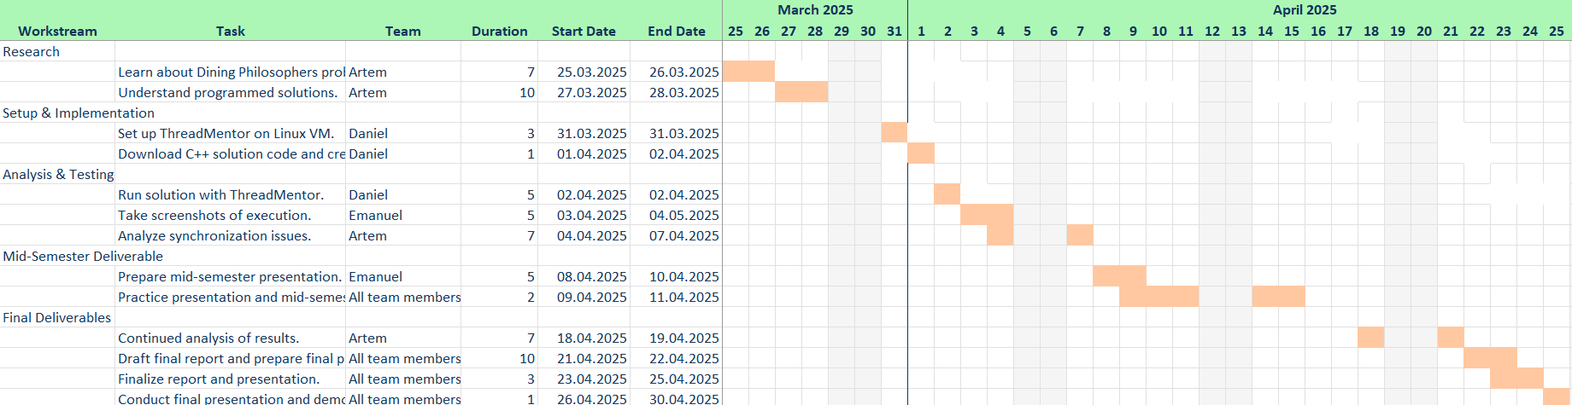
7 Appendix: Project Planning and Management
Gantt Chart
Task Distribution
Notes:
This is Appendix: Project Planning and Management Part
Danyil/Artem
We began the project with a collaborative research phase, where all members of the group collaborated to develop a rich understanding of:
The Dining Philosophers Problem.
The challenges of concurrency in operating systems.
Mutex locks and synchronization methods.
Once we were certain of our shared understanding, we divided tasks based on interests and strengths:
Research and Theoretical Background: Each member researched and summarized OS concepts, synchronization issues, and mutexes.
Writing the Report: We divided the roles of the report among us. Each member had a section to work on (e.g., implementation, analysis, or thoughts), apart from reading and proofreading one another's work.
1 Introduction — Danyil
2 Mutex Lock Solution – Emanuel
3 Results and Analysis:
3.1 Program Execution Overview – Artem
3.2 Program Execution Window Explaining – Artem
3.3 History Graph & Thread Status Screenshots and Captions – Emanuel
3.4 Code Snippets Corresponding to ThreadMentor Tags – Danyil
3.5 Detailed Behavior Analysis of Philosopher Threads – Artem
3.6 Discussion of Deadlock and Starvation Risks – Artem & Danyil
4 Conclusions – Danyil
5 References – Collaborative
6 Appendix: Personal Reflections – Collaborative
7 Appendix: Project Planning and Management – Collaborative

Slide 55
© 30/04/2025 | Danyil Tymchuk & Artem Surzhenko & Emanuel Avram

